Slide 1
Object Oriented Methodologies
II
Dr. Ranjana Vyas
DAAD Fellow
Indian Institute of Information Technology, Allahabad

Slide 2
OOSE
OOSE for Projects: Why ?
  OOM Vs Object Oriented Software Engineering
OOA&D : What is Object Oriented Modeling?
  How to Model given Software project?
  Analysis & Modeling: Why we need ?
OO Modeling: Class Identification for Software Projects
Class Identification: : Abotte’s Technique & Noun – Verb Analysis
OOM : Design with UML
Recent trends in OOM: Software Design criterion
Design Principles
GoF & Design Patterns

Slide 3
Object Oriented Software Development involves
OOSE….

Slide 4
Object-Oriented Software Engineering
Software engineering
  A discipline whose aims are
    The production of fault-free software,
    Delivered on time and within budget,
    That satisfies the client’s needs
    Furthermore, the software must be easy to modify when the client’s needs change
Object-oriented software engineering
  A discipline that utilizes the object-oriented methodology ( OOM ) to achieve the aims of software engineering
Notes:
Ranjana vyas

Slide 5
OOM for Software Project
Case Study

Slide 6
OOM for Software Project: ATM case study
The software to be designed & developed will control a Simulated Automated Teller Machine (ATM) having;
  a magnetic stripe reader for reading an ATM card,
  a customer console (keyboard and display) for interaction with the customer,
  a slot for depositing envelopes, a dispenser for cash (in multiples of Rs.100/-),
  a printer for printing customer receipts, and a key-operated switch to allow an operator to start or stop the machine.
  The ATM will communicate with the bank's computer over an appropriate communication link.
Notes:
Ranjana vyas

Slide 7
OOSE
The step-by-step progression towards the successful completion of the project will require ;
Begin with the Requirements and User Interface.
The first task that must be performed in any project is clearly understanding the requirements.
  OOA
Then view the Use Cases and Further Analysis.
Analysis is begun by identifying the use cases that follow from the requirements, and detailing a flow of events for each.
Further analysis identifies the key classes that are suggested by the use cases,
  OOA & D
Notes:
Ranjana vyas

Slide 8
OOAD
The Further Analysis deals with both the "big picture" and the details of the various use cases by a discussion of how the key objects would need to interact in order to implement the use case.
The detailed design is developed by spelling out the attributes and methods for each class.
OOAD is required for the System Analysis and design but also as a big project will involve many persons as team members.
  Some are expert designers
  Some are expert coders .. ( topcoders!)
  Some are System testers..
We need a universally understandable detailing using Object Oriented Modeling…
Notes:
Ranjana vyas

Slide 9
OOAD
Object-oriented design (OOD) paradigm suggests that the natural objects occurring in a problem should be identified first and then implemented.
  Object-oriented design (OOD) techniques not only identify Class/Objects but also identify the internal details of these identified objects.
Also, the relationships existing among different Class / objects are identified and represented in such a way that the objects can be easily implemented using a programming language.
Notes:
Ranjana vyas

Slide 10
OOA & OOD
The term object-oriented analysis (OOA) refers to a method of developing an initial model of the software from the requirements specification.
  The analysis model is refined into a design model.
The design model can be implemented using a programming language, using object-oriented concepts like Inheritance, Polymorphism. etc
Notes:
Ranjana vyas

Slide 11
OOA&D
Why ?
  Medium / big sized software projects needs
How?
  Understanding the Problem Domain more deeply.
  Performing Requirement Analysis & finalizing System design
  Identifying the Objects, attributes and methods.
  Interaction among Objects
Tools / Standards?
  UML / starUML / Rational Rose
Notes:
Ranjana vyas

Slide 12
OOM for OOM
( Object Oriented Modeling for
Object Oriented Methodology )
Notes:
Ranjana vyas

Slide 13
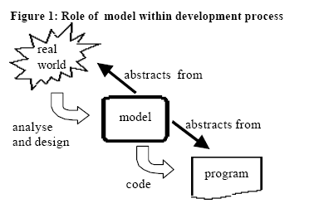
OOM
Heart of object-oriented Analysis & Design is the construction of a model.
The model abstracts the essential details of the underlying problem from its usually complicated real world. This assumes special significance in handling medium/large sized software projects
The OO model is then implemented in to programs using any OO Programming language.
Notes:
Ranjana vyas

Slide 14
Class / Object identification is first step towards Object Oriented Modeling…

Slide 15
Class identification is a Hard Problem
Main problems:
  What are various Classes…
    Classes/Objects are inside the system
  Relationship between various Classes
  Finalize the Design…then implement
An other problem: Classes/Objects are not just found by taking a picture of a scene or domain
  The application domain has to be analyzed

Slide 16
Finding Participating Objects in Use Cases
Pick a use case and look at flow of events..(We will discuss later)
Do a textual analysis (noun-verb analysis)
  Nouns are candidates for objects/classes
  Verbs are candidates for operations -Abbott’s Technique
After objects/classes are found, identify their types & relationships
  Identify real world entities that the system needs to keep track of.
  Identify real world procedures that the system needs to keep track of.
  Identify inheritance, polymorphic parameters...
Notes:
Take the flow of events and find participating objects in use cases and scenarios (flow of events)
This technique can also be used to do a textual analysis of the whole problem statement, but that is quite an undertaking. When analysing only event flows, we have a better focus and the technique is more useful
Pick a use case and look at flow of events
Find terms that need to be clarified in order to understand the flow of events
Look for recurring nouns (e.g., Incident)
Identify real world entities that the system needs to keep track of (e.g., FieldOfficer)
Identify real world procedures that the system needs to keep track of (e.g., EmergencyOperationsPlan)
Identify interface artifacts (e.g., PoliceStation)
Be prepared that some objects are still missing and need to be found:
Model the flow of events with a sequence diagram
Always try to use the clients or end users terminology

Slide 17
Class identification: Using Abbot’s Technique
Flow of Events:
The customer enters the store to buy a toy.
It has to be a toy that his daughter likes and it must cost less than 50 Euro.
He tries a videogame, which uses a data glove and a head-mounted display. He likes it.
An assistant helps him.
The suitability of the game depends on the age of the child.
His daughter is only 3 years old.
The assistant recommends another type of toy, namely the boardgame “Monopoly".
Notes:
Question: Is this a good use case flow of events description? Answer: Not quite., the whole event flow actually reads more as if it is still a scenario “Monopoly” is probably a left over from the scenario
Question: Does the event flow finish correctly? Answer: The description should terminate with the customer leaving the store

Slide 18
Mapping parts of speech to model components (Abbot’s Technique)
Example
Part of speech
OO Component
“Monopoly”
Proper noun
object
Toy
Improper noun
class
Buy, recommend
Doing verb
operation
is-a
being verb
inheritance
has an
having verb
aggregation
must be
modal verb
constraint
dangerous
adjective
attribute
enter
transitive verb
operation
depends on
intransitive verb
constraint, class,
association
Notes:
First proposed by Abbot in an article for the Communication of the ACM in 1983

Slide 19
Generating a Class Diagram from Flow of Events
Customer
Flow of events:
customer enters
The customer enters the store to buy a toy. It has to be a toy that his daughter likes and it must cost less than 50 Euro. He tries a videogame, which uses a data glove and a head-mounted display. He likes it.
?
enter()
store
enter()
daughter
age
daughter
suitable
An assistant helps him. The suitability of the game depends on the age of the child. His daughter is only 3 years old. The assistant recommends another type of toy, namely a boardgame. The customer buy the game and leaves the store
*
Toy
price
buy()
like()
toy
buy()
toy
videogame
boardgame

Slide 20
OO Modeling standards
Although there were many efforts for OO modeling standards.
In the 1980s Grady Booch published a paper on how to design for Ada but gave it the title: Object-Oriented Design.
Booch was able to extend his ideas to a genuinely object-oriented design method by 1991 in his book with the same title, revised in 1993 (Booch, 1994).
Booch’s method became very popular in C++ programmers.
In 1994 there were. over 72 methods or fragments of methods for OOM. The OO community soon realized that this situation was untenable if the technology was to be used commercially on any significant scale.
Jim Rumbaugh , another influential OO modeling expert, join Grady Booch at Rational Inc. & two merged their notations into what became the first version of UML (Booch et al., 1999).
Later they were joined by Ivar Jacobson who added elements of his Objectory notation and began the development of the Rational Unified Process (RUP).
Notes:
Ranjana vyas

Slide 21
Objectory
Objectory was a proprietary method that had been around much longer than most object-oriented methods. It originated in the Swedish telecommunications industry.
Emerged in its object-oriented guise when Jacobson et al. (1992) published part of it (OOSE) in book form.
The major contribution of this method was the idea that analysis should start with use cases rather than with a class model.
The classes were then to be derived from the use cases. The technique marked an important step forward in object-oriented analysis and has been widely adopted,
Objectory was the first OO method to include a bona fide, although partial, development process.
Notes:
Ranjana vyas

Slide 22
UML : An introduction
UML, or Unified Modeling Language, is a specification language.
UML is a family of graphical notations, backed by single meta-model, that help in describing and designing software systems, particularly software systems built using the object-oriented (OO) style.
It can be defined as a general purpose language that uses a graphical designation which can create an abstract model.
UML is a few different things to different people. This comes both from its own history and from the different views that people have about what makes an effective software engineering process.
Notes:
Ranjana vyas

Slide 23
UML
A characterization of the three modes in which people use the UML:
sketch,
blueprint, and
programming language.
By far the most common of the three, is UML as sketch.
In this usage, developers use the UML to help communicate some aspects of a system.
We can use sketches in a forward-engineering or reverse-engineering direction.
Forward engineering draws a UML diagram before you write code, while reverse engineering builds a UML diagram from existing code in order to help understand it.
Notes:
Ranjana vyas

Slide 24
UML for Sketching
Our aim is to use the sketches to help communicate ideas and alternatives about what you're about to do.
We don't talk about all the code you are going to work on, only important issues that you want to draw sections of the design that you want to visualize before you begin programming.
UML diagrams for such purposes can depict both the Structural and Behavioral aspects of the system
Notes:
Ranjana vyas

Slide 25
UML as Blueprint
In contrast, UML as blueprint is about completeness !
In forward engineering, the idea is that blueprints are developed by a designer whose job is to build a detailed design for a programmer to code up.
That design should be sufficiently complete in that all design decisions are laid out, and the programmer should be able to follow it as a pretty straightforward activity that requires little thought.
The designer may be the same person as the programmer, but usually the designer is a more senior developer who designs for a team of programmers.
Notes:
Ranjana vyas

Slide 26
UML
UML provides different view of the same system from different viewpoint so that we may know it in totality;
User’s view of the System
Structural view of the System.
Behavioral View of System
Implementation View of System
Deployment View of System
Notes:
Ranjana vyas

Slide 27
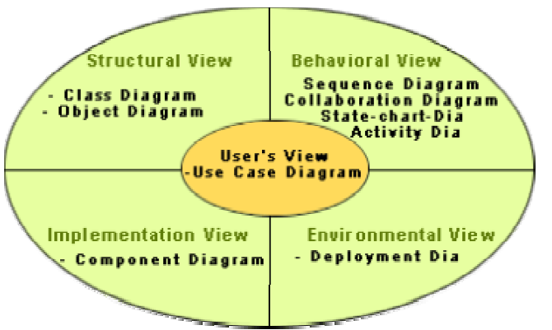
UML: Different View diagrams
Notes:
Ranjana vyas

Slide 28
UML
At the center of the UML are its nine kinds of modeling diagrams;.
Use case diagrams
Class diagrams
Object diagrams
Sequence diagrams
Collaboration diagrams
Statechart diagrams
Activity diagrams
Component diagram
Deployment diagram
Notes:
Ranjana vyas

Slide 29
What is a Use-Case
A use case is a description of a system’s behavior as it responds to a request that originates from outside of that system.
In other words, a use case describes "who" can do "what" with the system in question.
The use case technique is used to capture a system's behavioral requirements by detailing scenario-driven threads through the functional requirements.
Notes:
Ranjana vyas

Slide 30
UML techniques in Software Engineering
Requirements Analysis
Use cases, which describe how people interact with the system.
A class diagram drawn from the conceptual perspective, which can be a good way of building up a rigorous vocabulary of the domain.
An activity diagram, which can show the work flow of the organization, showing how software and human activities interact. An activity diagram can show the context for use cases and also the details of how a complicated use case works.
A state diagram, which can be useful if a concept has an interesting life cycle, with various states and events that change that state.
.
Notes:
Ranjana vyas

Slide 31
UML techniques
Design
Class diagrams from a software perspective. These show the classes in the software and how they interrelate.
Sequence diagrams for common scenarios.
  A valuable approach is to pick the most important and interesting scenarios from the use cases and use CRC cards or sequence diagrams to figure out what happens in the software.
Package diagrams to show the large-scale organization of the software.
State diagrams for classes with complex life histories.
Deployment diagrams to show the physical layout of the software
Notes:
Ranjana vyas

Slide 32
UML Diagrams for OOM
UML diagrams depicts various aspects of a system.
While Structural diagrams provides the static view of the system, the Behavioral diagrams shows the Interaction among various system components.
UML Diagrams are thus categorised into STATIC and DYNAMIC Modeling diagrams as well.
Notes:
Ranjana vyas

Slide 33
Dynamic modeling
As the software system continuously changes ( in states, activities, and collaborations) during life time, therefore it is needful to model it and following are grouped in the dynamic modeling diagrams of UML;
States
Sequences
Collaborations
Activities
These diagram shows how objects interact dynamically, during execution time of the system.
Notes:
Ranjana vyas

Slide 34
dynamic modeling diagrams
There are following four diagrams, who represent the behavioral view of the system and as behavior is a dynamic phenomenon, the diagrams are also categorized as Dynamic modeling diagrams
State diagrams – describes different states an object can have during its life cycle, behavior in the states, events that can change states
Sequence diagrams – describes how objects interact and communicate with each other with the focus on time
Collaboration diagrams – also describes how objects interact, but the focus is on space
Activity diagrams – another way to show interaction but the focus is on work

Slide 35
UML
At the center of the UML are its nine kinds of modeling diagrams, which we describe here.
Use case diagrams
Class diagrams
Object diagrams
Sequence diagrams
Collaboration diagrams
Statechart diagrams
Activity diagrams
Component diagram
Deployment diagram
Notes:
Ranjana vyas

Slide 36
Use case diagrams
Use case diagrams describe what a system does from the standpoint of an external observer. The emphasis is on what a system does rather than how.
The primary components of a use-case model are ;
  Use-cases,
  Actors, and
  the system modeled
The use case model for any system consists of a set of “use cases”. Intuitively, use cases represent the different ways in which a system can be used by the users.
A simple way to find all the use cases of a system is to ask the question: “What the users can do using the system?”
Use case diagrams are closely connected to scenarios
Notes:
Ranjana vyas

Slide 37
Use-Case diagram
Here is a scenario for a medical clinic.
"A patient calls the clinic to make an appointment for a yearly checkup. The receptionist finds the nearest empty time slot in the appointment book and schedules the appointment for that time slot. "
A use case is a summary of scenarios for a single task or goal.
An actor is who or what initiates the events involved in that task.
Actors are simply roles that people or objects play. The picture shown next is a Make Appointment use case for the medical clinic.
Notes:
Ranjana vyas

Slide 38

Use Case diagram
Actors are stick figures. Use cases are ovals.
Communications are lines that link actors to use cases.
A use case diagram is a collection of actors, use cases, and their communications.
The actor is a Patient.
The connection between actor and use case is a communication association (or communication for short).
Notes:
Ranjana vyas

Slide 39
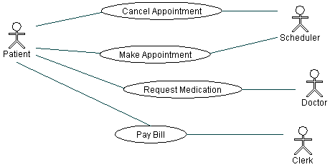
Use Case diagram
We've put Make Appointment as part of a diagram with four actors and
four use cases.
Notes:
Ranjana vyas

Slide 40
Use Case diagram
Use case diagrams are helpful in three areas.
determining features (requirements). New use cases often generate new requirements as the system is analyzed and the design takes shape.
communicating with clients. Their notational simplicity makes use case diagrams a good way for developers to communicate with clients.
generating test cases. The collection of scenarios for a use case may suggest a suite of test cases for those scenarios.
Notes:
Ranjana vyas

Slide 41
Requirement Analysis
&
Use Case diagram for
ATM Software
Notes:
Ranjana vyas

Slide 42
OOM for Software Project: ATM case study
The software to be designed & developed will control a Simulated Automated Teller Machine (ATM) having;
  a magnetic stripe reader for reading an ATM card,
  a customer console (keyboard and display) for interaction with the customer,
  a slot for depositing envelopes, a dispenser for cash (in multiples of Rs.100/-),
  a printer for printing customer receipts, and a key-operated switch to allow an operator to start or stop the machine.
  The ATM will communicate with the bank's computer over an appropriate communication link.
Notes:
Ranjana vyas

Slide 43
Simulated ATM Case Study
The step-by-step progression will require following;
Begin with the Requirements and User Interface.
The first task that must be performed in any project is clearly understanding the requirements.
Then view the Use Cases and Further Analysis.
Analysis is begun by identifying the use cases that follow from the requirements, and detailing a flow of events for each.
Further analysis identifies the key classes that are suggested by the use cases,
Notes:
Ranjana vyas

Slide 44
ATM Software
It will service one customer at a time who will be required to enter a (PIN)-sent to the bank for validation as part of each transaction.
The customer will then be able to perform one or more transactions.
ATM is able to provide the following services to the customer:
A customer must be able to make a cash withdrawal in multiples of Rs.100/. Approval needed from the bank before cash is dispensed.
A customer must be able to make a deposit to any account linked to the card, consisting of cash and/or checks in an envelope.
The customer will enter the amount of the deposit into the ATM, subject to manual verification when the envelope is removed from the machine by an operator. Approval must be obtained from the bank before physically accepting the envelope.
A customer can make a transfer of money between any two A/C .
A customer must be able to make a balance inquiry of any account linked to the card.
A customer must be able to abort a transaction in progress by pressing the Cancel key .
Notes:
Ranjana vyas

Slide 45
ATM Software
What are the Actors & Use Cases in the given System?
There are following Actors;
Operator- who starts and closes the ATM machine.
Customer
Bank.
Operator will do following :-
  System Start up
  System shut down
Customer will do following :-
Perform the ATM session involving;
  Transaction in which
  Withdrawal, Deposit, Transfer of money &
  Inquiry related to Account
  will be performed
Bank will involved in the Transaction

Slide 46
ATM Software: Use Case diagram
As per the given scenario the Use Cases can be identified in the given System;
With 03 Actors, following Use Cases will be in the system;
System Startup Use Case
System Shutdown Use Case
Session Use Case
Transaction Use Case
Withdrawal Transaction Use Case
Deposit Transaction Use Case
Transfer Transaction Use Case
Inquiry Transaction Use Case

Slide 47
ATM : Transaction Use Case diagram
As shown in the given scenario the Transaction Use Case will be under ATM Session use case & needs to be further analyzed;
Transaction is an abstract generalization. Each specific concrete type of transaction implements certain operations in the appropriate way. The flow of events will describes the behavior common to all types of transaction. The flows of events for the individual types of transaction (withdrawal, deposit, transfer, inquiry) give the features that are specific to that type of transaction.
If the bank approves the transaction, any steps needed to complete the transaction (e.g. dispensing cash or accepting an envelope) will be performed, and then a receipt will be printed. Then the customer will be asked whether he/she wishes to do another transaction.
If the bank reports that the customer's PIN is invalid, the Invalid PIN extension will be performed and then an attempt will be made to continue the transaction. If the customer's card is retained due to too many invalid PINs, the transaction will be aborted, and the customer will not be offered the option of doing another.
All messages to the bank and responses back are recorded in the ATM's log.

Slide 48
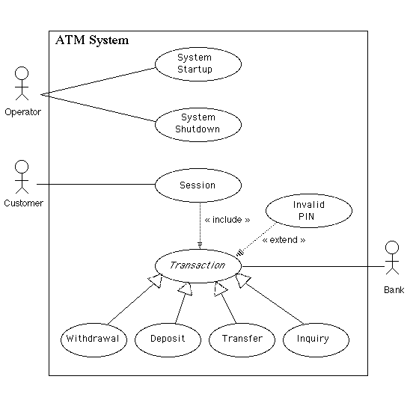
Use- Case diagram of the ATM system
Notes:
Ranjana vyas

Slide 49
OOM for OOM
( Object Oriented Modeling for
Object Oriented Methodology )
Notes:
Ranjana vyas

Slide 50
OOM for Software Project
Requirement Analysis: Use Case diagram
Design: Class & Object Modeling
Class Analysis
  CRC & Class Diagram
  Class Responsibility Collaboration
  Class Diagrams: Difficulties & Risks
Algorithm, Software Design & Design Patterns
  GoF & Design Pattern
  MVC & Java Struts
Notes:
Ranjana vyas

Slide 51
UML : Use Case & Class diagram
Use case diagrams describe what a system does from the standpoint of an external observer.
The emphasis is on what a system does rather than how.
Use case diagrams are closely connected to scenarios.
A scenario is an example of what happens when someone interacts with the system
Class Diagrams:
A class diagram describes the static structure of a system. It shows how a system is structured rather than how it behaves.
The static structure of a system comprises of a number of class diagrams and their dependencies.
Notes:
Ranjana vyas

Slide 52
OO Design & Class Analysis
Creating Classes based on the analysis of Use-Case diagrams will be significant step towards successful project design.
Creating Class diagram requires thinking at appropriate level of abstraction !
Making sure that our design is good means our Software developed thus fulfills objectives and avoids characteristics of a bad design :
  Rigidity - It is hard to change because every change affects too many other parts of the system.
  Fragility - When you make a change, unexpected parts of the system break.
  Immobility - It is hard to reuse in another application because it cannot be disentangled from the current application.
Notes:
Ranjana vyas

Slide 53
Good Software design : Difficulties & Risks
  Modeling is particularly difficult skill
    Even excellent programmers have difficulty thinking at the appropriate level of abstraction
    Education traditionally focus more on programming than modelling
  Resolution:
    Ensure that team members give adequate time on MODELING
    Discuss & Review all models thoroughly
    Have experienced modeler as part of the team

Slide 54
Software Project development and OOM
problem statement
Requirements
Analysis
Nonfunctional
requirements
Functional
Requirements
use case diagram
Analysis
class diagram
analysis object model
statechart diagram
dynamic model
System design
sequence diagram

Slide 55
Activities during Object Modeling
Main goal: Find the important abstractions
Steps during object modeling
  1. Class identification
    Based on the fundamental assumption that we can find abstractions
  2. Find the attributes
  3. Find the methods
  4. Find the associations between classes
Order of steps
  Goal: get the desired abstractions
  Order of steps secondary, only a heuristic
Notes:
Start with review: What is a model? What is an abstraction? They are used synonymously and mean they provide a simplified view of a complex system that we cannot understand by looking at all of its components simultaneously. Models by their definition abstract away important characteristics of a system by emphasizing other aspects.
Example: Clay model concentrates on the form of the car, nobody can sit in it.
Prototypes are models.
Iterate and correct the model: A scientific model is always like a hypothesis. The important part of a scientific model is that it is falsifiable. This is an important aspect of prototyping. They are immediately understandable and can be falsified (that is our theory of how the application should work!). This is one of the main strengths of prototyping: End user falsifiability.
Redesign (Falsification principle in science: Work with model until it is proven to be false)

Slide 56
Class Identification
Class identification is crucial to Object-Oriented modeling
  Helps to identify the important entities of a system
Basic assumptions:
  1. We can find the classes for a new software system (Forward Engineering)
  2. We can identify the classes in an existing system (Reverse Engineering)
Why we do this?
  Good design…...

Slide 57
Class Identification
Approaches
  Application domain approach
    Ask application domain experts to identify relevant abstractions
  Syntactic approach
    Start with use cases
    Analyze the text to identify the objects
    Extract participating objects from flow of events
  Design patterns approach
    Use reusable design patterns
  Component-based approach
    Identify existing solution classes.
Notes:
Finding objects is the key in object modeling
Application domain approach (not a special lecture, examples):
Syntactic approach (this lecture):
Design patterns approach (Lecture on design patterns)
Component-based approach (Lecture on object design):

Slide 58
Class identification is a Hard Problem
One problem: Definition of the system boundary:
  Which abstractions are outside, which abstractions are inside the system boundary?
    Actors are outside the system
    Classes/Objects are inside the system.
An other problem: Classes/Objects are not just found by taking a picture of a scene or domain
  The application domain has to be analyzed
  Depending on the purpose of the system different objects might be found
    How can we identify the purpose of a system?
    Scenarios and use cases => Functional model

Slide 59
There are different types of Objects
Entity Objects
  Represent the persistent information tracked by the system. (Application domain objects, also called “Business objects”)
Boundary Objects
  Represent the interaction between the user and the system
Control Objects
  Represent the control tasks performed by the system.
Notes:
Be prepared that some objects are still missing and need to be found:
Model the flow of events with a sequence diagram
Always use the clients or end users terminology

Slide 60
C++ code of the Person class
#include <iostream>
class Person{
private:
char name[20];
int yearOfBirth;
public:
Person(char *theName, int theYear) {
yearOfBirth = theYear;
sprintf(name, theName);
}
void jump() {
std::cout << name <<
" jumps" << std::endl;
}
int getAge(int thisYear) {
return thisYear - yearOfBirth;
}
};
Name
Private data
(attributes)
Initialisation
(constructor)
Public
behaviour
(methods)

Slide 61
Java code of the Person class
Name
public class Person {
private String name;
private int yearOfBirth;
public Person(String theName, int theYear) {
name = theName;
yearOfBirth = theYear;
}
public void jump() {
System.out.println(name + " jumps");
}
public int getAge(int thisYear) {
return thisYear - yearOfBirth;
}
}
Private data
(attributes)
Initialisation
(constructor)
Public
behaviour
(methods)

Slide 62
UML diagram of the
Person class
Person
-name: string
-yearOfBirth: int
+create(theName: string ,theYear: int)
+jump()
+getAge(this year: int):int
Name
Private data
(attributes)
Initialisation
(constructor)
Public
behaviour
(methods)

Slide 63
Class diagrams
A Class diagram gives an overview of a system by showing its classes and the relationships among them.
Class diagrams are static -- they display what interacts but not what happens when they do interact.
The main symbols shown on class diagrams are:
  Classes
      represent the types of data themselves
  Associations
      represent linkages between instances of classes
  Attributes
      are simple data found in classes and their instances
  Operations
      represent the functions performed by the classes and their instances
  Generalizations :group classes into inheritance hierarchies
Notes:
Ranjana vyas

Slide 64
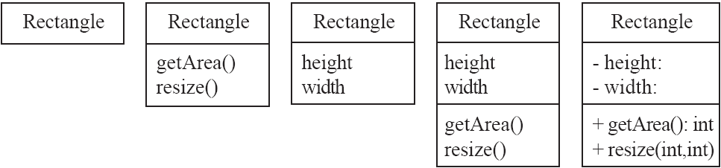
Classes
A class is simply represented as a box with the name of the class inside
  The diagram may also show the attributes and operations
  The complete signature of an operation is:
    operationName(parameterName: parameterType …): returnType

Slide 65
Class diagram
UML class notation is a rectangle divided into three parts: class name, attributes, and operations.
Names of abstract classes, such as Payment, are in italics.
Relationships between classes are the connecting links.
association -- a relationship between instances of the two classes.
There is an association between two classes if an instance of one class must know about the other in order to perform its work.
In a diagram, an association is a link connecting two classes.
Notes:
Ranjana vyas

Slide 66
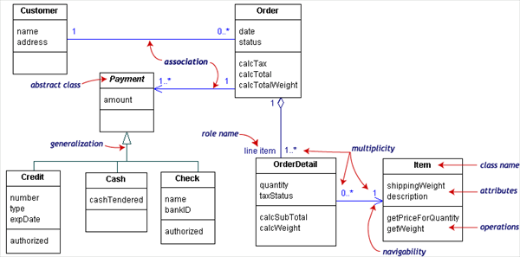
Class diagram
The class diagram showed below models a customer order from a retail catalog.
The central class is the Order. Associated with it are the Customer making the purchase and the Payment. A Payment is one of three kinds: Cash, Check, or Credit. The order contains OrderDetails (line items), each with its associated Item.
Notes:
Ranjana vyas

Slide 67
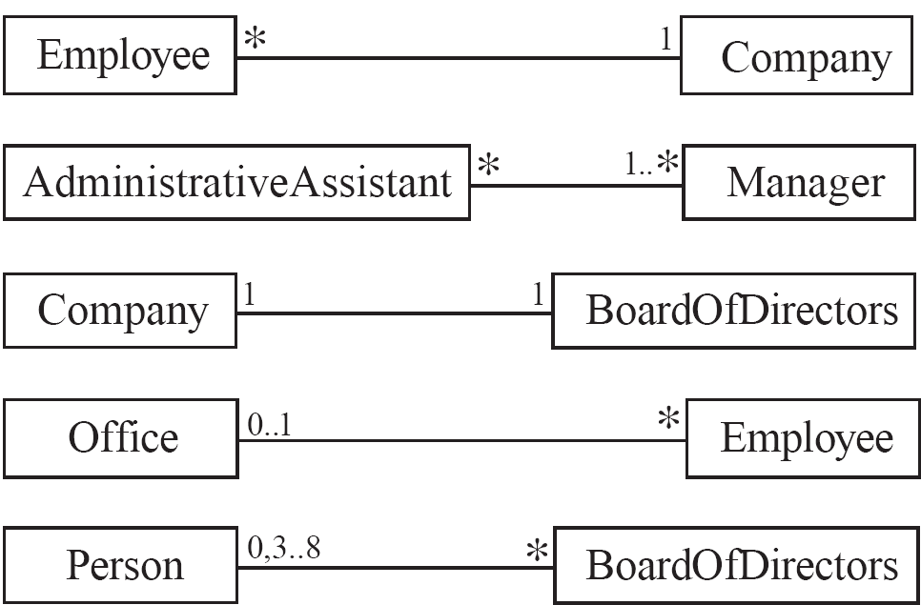
Associations and Multiplicity
An association is used to show how two classes are related to each other
  Symbols indicating multiplicity are shown at each end of the association

Slide 68
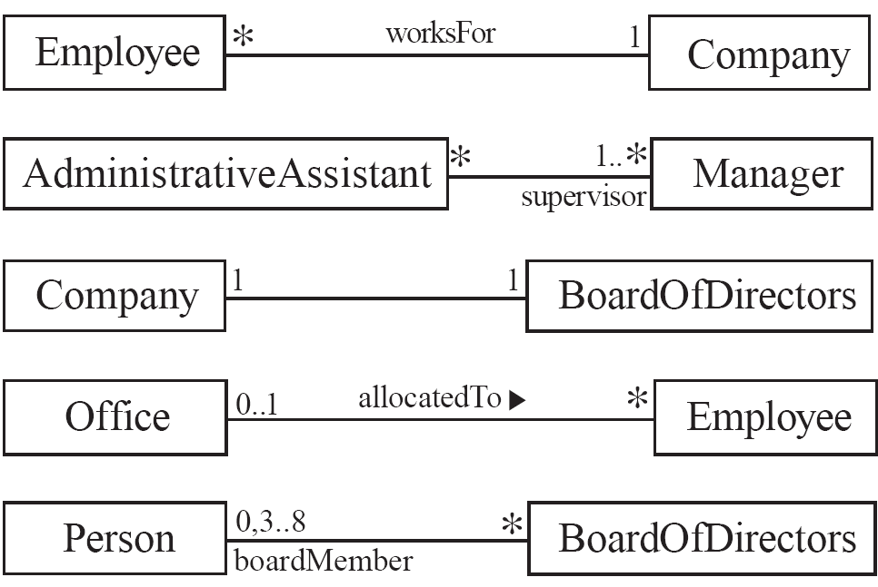
Labelling associations
  Each association can be labelled, to make explicit the nature of the association

Slide 69
Analyzing and validating associations
  Many-to-one
    A company has many employees,
    An employee can only work for one company.
      This company will not store data about the moonlighting activities of employees!
    A company can have zero employees
      E.g. a ‘shell’ company
    It is not possible to be an employee unless you work for a company
Employee
*
worksFor
1
Company

Slide 70
Analyzing and validating associations
  Many-to-many
    An assistant can work for many managers
    A manager can have many assistants
    Assistants can work in pools
    Managers can have a group of assistants
    Some managers might have zero assistants.
    Is it possible for an assistant to have, perhaps temporarily, zero managers?
*
1..*
*
*
*
*
Assistant
*
Manager
supervisor

Slide 71
Analyzing and validating associations
  One-to-one
    For each company, there is exactly one board of directors
    A board is the board of only one company
    A company must always have a board
    A board must always be of some company
1
1

Slide 72
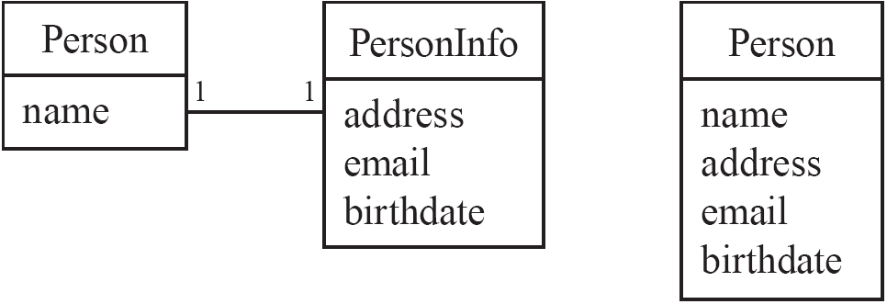
Analyzing and validating associations
Avoid unnecessary one-to-one associations
Avoid this do this

Slide 73
Steps in Generating Class Diagrams
Class identification (textual analysis, domain expert)
Identification of attributes and operations (sometimes before the classes are found!)
Identification of associations between classes
Identification of multiplicities
Identification of roles
Identification of inheritance
Notes:
This is a list of activities you need to perform when generating class diagrams, not necessarily in this order.

Slide 74
Who uses Class Diagrams?
Purpose of class diagrams
  The description of the static properties of a system
The main users of class diagrams:
  The application domain expert
    uses class diagrams to model the application domain (including taxonomies)
      during requirements elicitation and analysis
  The developer
    uses class diagrams during the development of a system
      during analysis, system design, object design and implementation.

Slide 75
Who does not use Class Diagrams?
The client and the end user are usually not interested in class diagrams
  Clients focus more on project management issues
  End users are more interested in the functionality of the system.

Slide 76
Creating Quality Classes & Design
Drawing a Class Diagram does not suffice that our design is good !!
Creating quality claases
Assigning appropriate responsibility to each Class requires analytical thinking.
  CRC Cards
The Quality of Classes should be kept high from the Design perspective.
  Functional Independence

Slide 77
Design Objectives
The software design method aid the designer by providing the following;
A Mechanism translating the physical problem to its design representation.
A notation for representing functional components and their interfaces.
Heuristics for refinement and Partitioning.
Functional independence: Cohesion & Coupling.

Slide 78
Functional Independence
The main goal (almost not evident) of design (from a low-level perspective) is to minimize coupling and maximize cohesion.
Coupling is the level of interdependency between a method and the environment, (other methods, objects and classes), while cohesion is the level of uniformity of the method goal.
While coupling needs a low-level perspective, cohesion needs an higher point of view. All patterns tends to reach these two objectives. Exactly knowing DP goals, we can more correctly apply the Design Patterns, apply one of it without knowing nothing about it and, perhaps, try to invent another one.
Notes:
Ranjana vyas

Slide 79
OOM : design metrics
Main objectives :
- to build highly cohesive classes
- to maintain loose coupling between those classes.
High-cohesion results in well-structured classes.
Loose coupling means more flexible, extensible software.
Applying this to the design and code helps determine whether project goals have been achieved.

Slide 80
Cohesion
Classes contain certain data and exhibit certain behavior.
Cohesive means that a certain class
performs a set of closely related actions.
A lack of cohesion means that a class is performing several unrelated tasks.
Lack of cohesion may never have an impact on the overall functionality of a particular class—or of the application itself
However, the application software will eventually become unmanageable.

Slide 81
Class Responsibility Collaboration
CRC cards are a brainstorming tool used in the design of object-oriented software:
They are typically used when first determining which classes are needed and how they will interact.
CRC cards are usually created from index cards on which are written:
The class name
Its Super and Sub classes (if applicable)
The responsibilities of the class.
The names of other classes with which the class will collaborate to fulfill its responsibilities.
Author
Notes:
Ranjana vyas

Slide 82
Allocating responsibilities to classes
A responsibility is something that the system is required to do.
  Each functional requirement must be attributed to one of the classes;
    All the responsibilities of a given class should be clearly related.
    If a class has too many responsibilities, consider splitting it into distinct classes
    If a class has no responsibilities attached to it, then it is probably useless
    When a responsibility cannot be attributed to any of the existing classes, then a new class should be created
  To determine responsibilities
    Perform use case analysis
    Look for verbs and nouns describing actions in the system description
© Lethbridge/Laganière 2005
Chapter 5: Modelling with classes

Slide 83
Categories of responsibilities
  Creating and initializing new instances
  Loading to and saving from persistent storage
  Destroying instances
  Setting and getting the values of attributes
  Computing numerical results
  Adding and deleting links of associations
  Copying, converting, transforming, transmitting or outputting
  Navigating and searching
  Other specialized work
© Lethbridge/Laganière 2005
Chapter 5: Modelling with classes

Slide 84
ATM Software
We have studied the concepts of
  Use Case Diagram
  Class Diagram
  To develop these STATIC Diagrams for ATM System.
  Dynamic modeling diagrams
    Develop dynamic diagrams for ATM Systems
Notes:
Ranjana vyas

Slide 85
Use- Case diagram: Analysis for Classes
Notes:
Ranjana vyas

Slide 86
ATM : Analysis for Classes
As initial in the Use Case diagram, now Classes needs to be analyzed;
A controller object representing the ATM itself (managing the boundary objects as listed )
Controller objects corresponding to use cases.
Session
Transaction
Boundary objects representing the individual component parts of the ATM:
  Operator panel.
  Card reader.
  Customer console, consisting of a display and keyboard.
  Network connection to the bank.
  Cash dispenser.
  Envelope acceptor. & Receipt printer.

Slide 87
Class Analysis
Controller objects; class ATM can handle the Startup and Shutdown use cases itself, so these do not give rise to separate objects here.
  Session
  Transaction (abstract generalization, responsible for common features, with concrete specializations responsible for type-specific portions)
An entity object representing the information encoded on the ATM card inserted by customer.
An entity object representing the log of transactions maintained by the machine.
Notes:
Ranjana vyas

Slide 88
CRC
Using CRC cards to assign responsibilities to various classes for the tasks required by the various use cases leads to the creation of the following cards.
Class ATM
Controller objects corresponding to the various use cases
  Class Session
  Class Transaction
  Class Withdrawal
  Class Deposit
  Class Transfer
  Class Inquiry
What about relations among these Classes?
Entity objects found necessary when assigning responsibilities to other object
Notes:
Ranjana vyas

Slide 89
CRC for Class ATM
Responsibilities Collaborators Start up when switch is turned on OperatorPanel
CashDispenser
NetworkToBank
Shut down when switch is turned off NetworkToBank
Start a new session when card is inserted by customer
CustomerConsoleSession
Provide access to component parts for sessions and transactions CustomerConsoleSession
Notes:
Ranjana vyas

Slide 90
Class Session
Responsibilities Collaborators Perform session use case ATM
CardReader
Card
CustomerConsole
Transaction
Update PIN value if customer has to re-enter it
Notes:
Ranjana vyas

Slide 91
CRC: Class CardReader
Responsibilities Collaborators
Tell ATM when card is inserted ATM
Read information from card Card Eject card
Retain card
Class Card
Responsibilities Collaborators
Represent information encoded on customer's ATM card
Notes:
Ranjana vyas

Slide 92
Class Diagram
In the ATM system, one of the responsibilities of the ATM is to provide access to its component parts for Session and Transaction objects; thus, Session and Transaction have associations to ATM, which in turn has associations to the classes representing the individual component parts.
(Explicit "uses" links between Session and Transaction, on the one hand, and the component parts of the ATM, on the other hand, have been omitted from the diagram to avoid making it excessively cluttered.)
The need for the various classes in the diagram was discovered at various points in the design process.
Notes:
Ranjana vyas

Slide 93
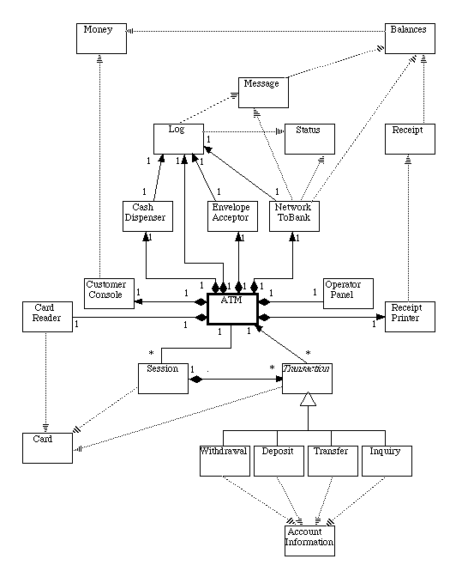
ATM Class diagram
Notes:
Ranjana vyas

Slide 94
Class diagram
Some classes were discovered when doing analysis
Some classes were discovered when doing CRC cards
  Message - used to represent a message to the bank.
  Receipt - used to encapsulate information to be printed on a receipt.
  Status - used to represent return value from message to the bank.
  Balances - used to record balance information returned by the bank
Notes:
Ranjana vyas

Slide 95
Class diagram
Some Classes were discovered when doing detailed design or writing code
  Money - used to represent money amounts, in numerous places.
  AccountInformation - contains names of various types of accounts customer can choose from
That is, OO design is not a "waterfall" process - discoveries made when doing detailed design and coding can impact overall system design.
To prevent the diagram from becoming overly large, only the name of each class is shown - the attribute and behavior "compartments" are shown in the detailed design, but are omitted here.
Notes:
Ranjana vyas

Slide 96
OO Design : Significance
Effective software design requires considering issues that may not become visible until later in the implementation and thus OO Design provides a tested ANAYTICAL approach adhering to Design Principles.
  Class Analysis: How to?
    Noun-phrase identification
  Different views of Class diagram
  GoF & Design Pattern
    OO Design Principles
  MVC & Java Struts

Slide 97
Class Identification
Approaches
  Application domain approach
    Ask application domain experts to identify relevant abstractions
  Syntactic approach
    Start with use cases
    Analyze the text to identify the objects
    Extract participating objects from flow of events
  Design patterns approach
    Use reusable design patterns
  Component-based approach
    Identify existing solution classes.
Notes:
Finding objects is the key in object modeling
Application domain approach (not a special lecture, examples):
Syntactic approach (this lecture):
Design patterns approach (Lecture on design patterns)
Component-based approach (Lecture on object design):

Slide 98
Class identification is a Hard Problem
One problem: Definition of the system boundary:
  Which abstractions are outside, which abstractions are inside the system boundary?
    Actors are outside the system
    Classes/Objects are inside the system.
An other problem: Classes/Objects are not just found by taking a picture of a scene or domain
  The application domain has to be analyzed
  Depending on the purpose of the system different objects might be found
    How can we identify the purpose of a system?
    Scenarios and use cases => Functional model

Slide 99
OO Design
If two modules interchange large amounts of data, then they are highly interdependent.
The degree of coupling between two modules depends on their interface complexity.
A module having high cohesion and low coupling is said to be functionally independent of other modules.
By the term functional independence, we mean that a cohesive module performs a single task or function.
A functionally independent module has minimal interaction with other modules.
The primary characteristics of neat module decomposition are high cohesion and low coupling.
Notes:
Ranjana vyas

Slide 100
OOSE Design Principles
Based on concepts of Object Orientation, these Design Principles are considered instrumental in developing a robust, flexible and maintainable Software ;
Open Closed Principle
Dependency Inversion Principle
Interface Segregation Principle
Single Responsibility Principle
Liskov's Substitution Principle

Slide 101
Finding Participating Objects in Use Cases
Pick a use case and look at flow of events
Do a textual analysis (noun-verb analysis)
  Nouns are candidates for objects/classes
  Verbs are candidates for operations-Abbott’s Technique
After objects/classes are found, identify their types
  Identify real world entities that the system needs to keep track of ( Entity Object)
  Identify real world procedures that the system needs to keep track of ( Control Object)
  Identify interface artifacts (  Boundary Object).
Notes:
Take the flow of events and find participating objects in use cases and scenarios (flow of events)
This technique can also be used to do a textual analysis of the whole problem statement, but that is quite an undertaking. When analysing only event flows, we have a better focus and the technique is more useful
Pick a use case and look at flow of events
Find terms that need to be clarified in order to understand the flow of events
Look for recurring nouns (e.g., Incident)
Identify real world entities that the system needs to keep track of (e.g., FieldOfficer)
Identify real world procedures that the system needs to keep track of (e.g., EmergencyOperationsPlan)
Identify interface artifacts (e.g., PoliceStation)
Be prepared that some objects are still missing and need to be found:
Model the flow of events with a sequence diagram
Always try to use the clients or end users terminology

Slide 102
Example for using the Technique
Flow of Events:
The customer enters the store to buy a toy.
It has to be a toy that his daughter likes and it must cost less than 50 Euro.
He tries a videogame, which uses a data glove and a head-mounted display. He likes it.
An assistant helps him.
The suitability of the game depends on the age of the child.
His daughter is only 3 years old.
The assistant recommends another type of toy, namely the boardgame “Monopoly".
Notes:
Question: Is this a good use case flow of events description? Answer: Not quite., the whole event flow actually reads more as if it is still a scenario “Monopoly” is probably a left over from the scenario
Question: Does the event flow finish correctly? Answer: The description should terminate with the customer leaving the store

Slide 103
Mapping parts of speech to model components (Abbot’s Technique)
Example
Part of speech
UML model component
“Monopoly”
Proper noun
object
Toy
Improper noun
class
Buy, recommend
Doing verb
operation
is-a
being verb
inheritance
has an
having verb
aggregation
must be
modal verb
constraint
dangerous
adjective
attribute
enter
transitive verb
operation
depends on
intransitive verb
constraint, class,
association
Notes:
First proposed by Abbot in an article for the Communication of the ACM in 1983

Slide 104
Generating a Class Diagram from Flow of Events
Customer
Flow of events:
customer enters
The customer enters the store to buy a toy. It has to be a toy that his daughter likes and it must cost less than 50 Euro. He tries a videogame, which uses a data glove and a head-mounted display. He likes it.
?
enter()
store
enter()
daughter
age
daughter
suitable
An assistant helps him. The suitability of the game depends on the age of the child. His daughter is only 3 years old. The assistant recommends another type of toy, namely a boardgame. The customer buy the game and leaves the store
*
Toy
price
buy()
like()
toy
buy()
toy
videogame
boardgame

Slide 105


